Slide 1
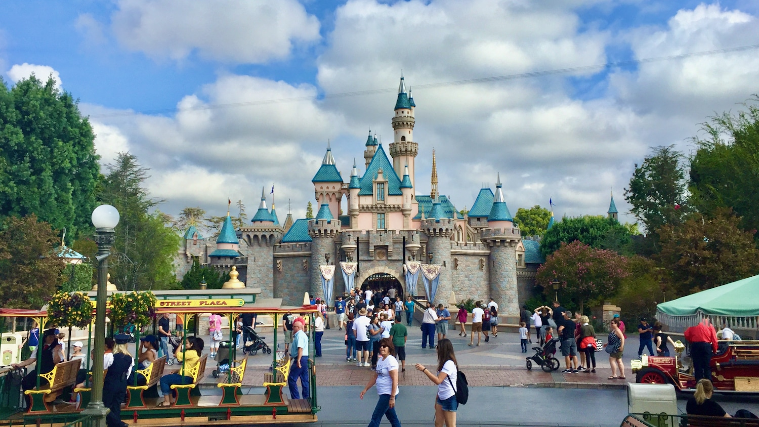
Sentiment analysis model for Disneyland California reviews
QUANG NHUT LY – 11055575
HEMANTH KOTHAPALLI – 11053675
This Photo by Unknown author is licensed under CC BY-NC-ND.

Slide 2
Marketing Idea & Motivation
Marketing Idea:
Utilize advanced sentiment analysis techniques to dissect and comprehend guest reviews at Disneyland California.
Gain profound insights into guest experiences, perceptions, and preferences.
Motivation:
Guest feedback is a valuable source of actionable insights, highlighting areas of excellence and improvement.
Staying attuned to evolving guest sentiments is imperative for maintaining relevance and competitiveness.

Slide 3
Data set
The data utilized in this study was sourced from the Kaggle website (https://www.kaggle.com/datasets/arushchillar/disneyland-reviews)
It was extracted from the original dataset, which comprises more than 42,000 reviews spanning 3 Disneyland branches - Paris, California, and Hong Kong. Employing the sample functions in R, 1000 negative(neu) 1000 positive(pos) 1000 neutral reviews. we categorized 1 and 2-star ratings as negative reviews, 3-star ratings as neutral, and 4 and 5-star ratings as positive reviews.

Slide 4
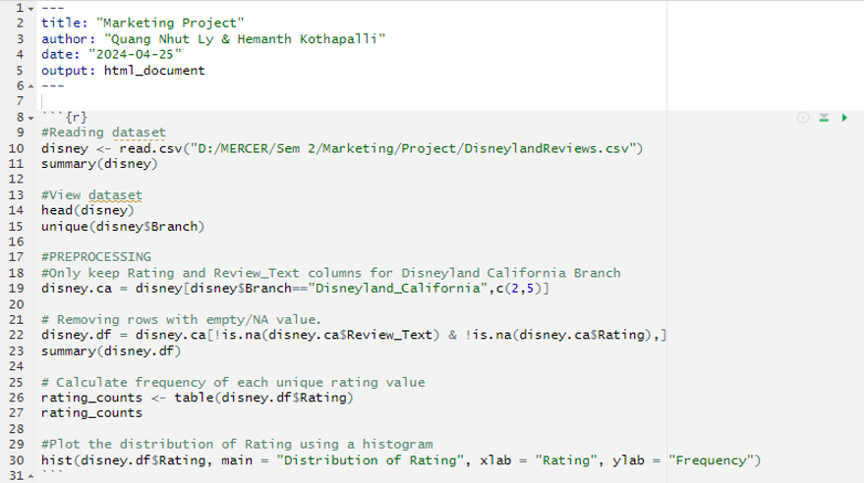
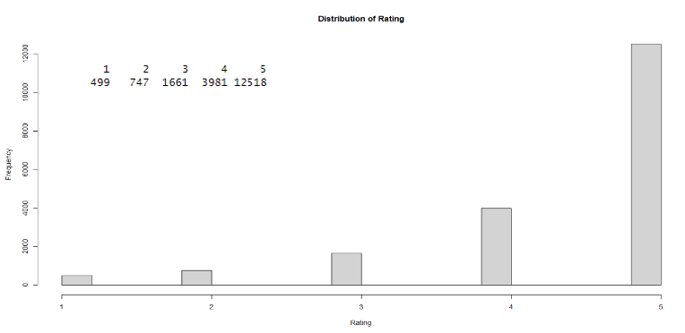
Data Preprocessing

Slide 5

Experiment Process
Text Processing
Tokenize
Filter Stopwords (English)
Transform Cases
Stem (Snowball)
Data Partition
Model Construction
Process Document from File
Select Attribute
Set Role
Cross Validation
Model Evaluation

Slide 6
TEXT MINING FOR SENTIMENT ANALYSIS & IMPORTANCE OF TEXT MINING IN MARKETING
Text mining for sentiment analysis involves preprocessing text data, tokenizing it, extracting features, and using k-NN algorithms to categorize it into positive, negative, or neutral sentiments, providing insights into customer opinions and market trends.
Text mining in marketing aids in sentiment analysis, enabling businesses to gauge customer satisfaction, track campaign impact, and segment customers based on their preferences. It also uncovers emerging trends, customer pain points, and market sentiments for strategic planning.

Slide 7
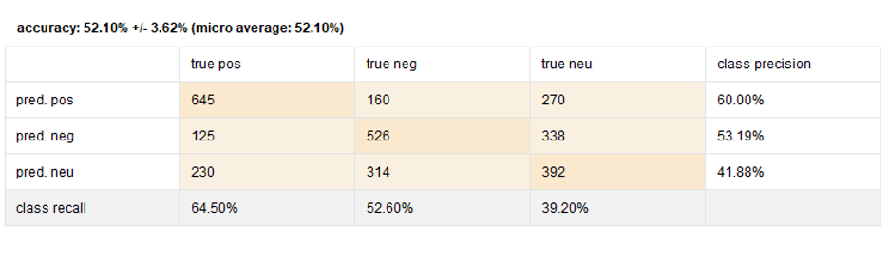
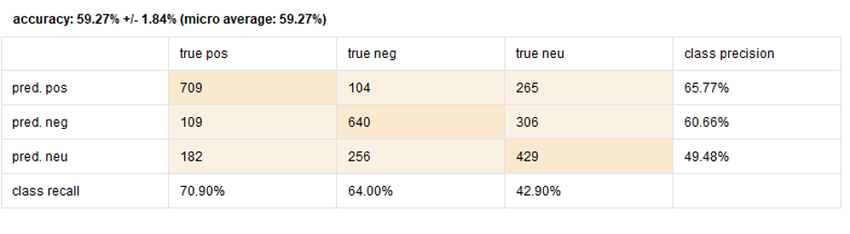
Model Results

Slide 8
Recommendations and Conclusion
Recommendations:
Feature Engineering
Ensemble Modeling
Fine-tuning Neutral Sentiment Prediction
Conclusion:
The sentiment analysis project for Disneyland California reviews offered valuable insights, despite modest overall accuracies. Better performance in predicting positive and negative sentiments compared to neutral sentiments was observed. Leveraging ensemble modeling, exploring additional features, and fine-tuning neutral sentiment prediction are recommended for enhancing model effectiveness.

Slide 9

Thank you

